Slide 1
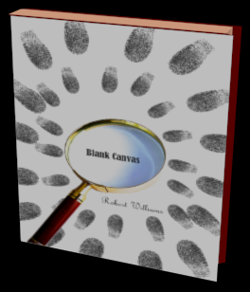
Product design Detective website
As a group we decided to create an interactive website which will be advertising a book. The website will act as a short prequel story to the book. It will require the user navigate the website and look for clues and evidence. The user will complete microgames/puzzles to obtain leads, eventually leading them to the diary of the killer.

Slide 2

Daniel: Engineer
Dominik: Artist
Carly: Designer
Jhulissa: Designer
Roles:

Slide 3
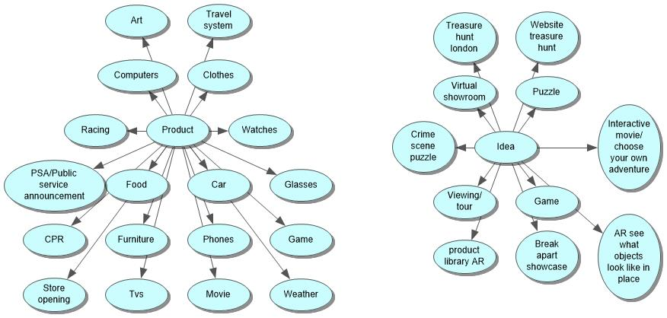
Ideation

Slide 4
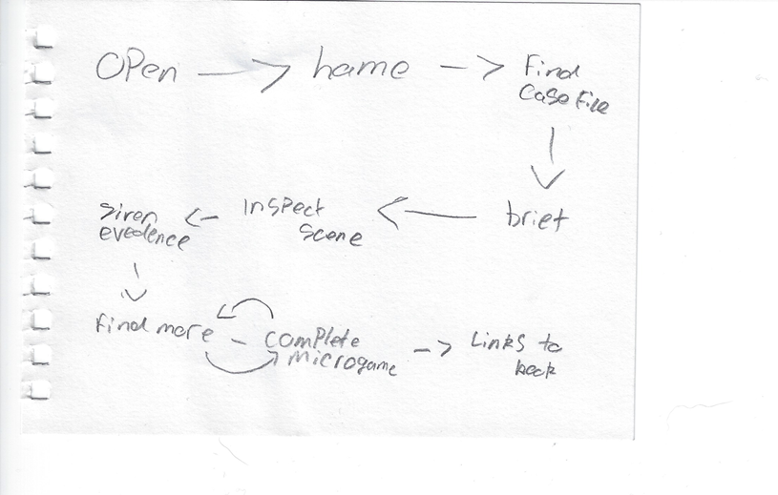
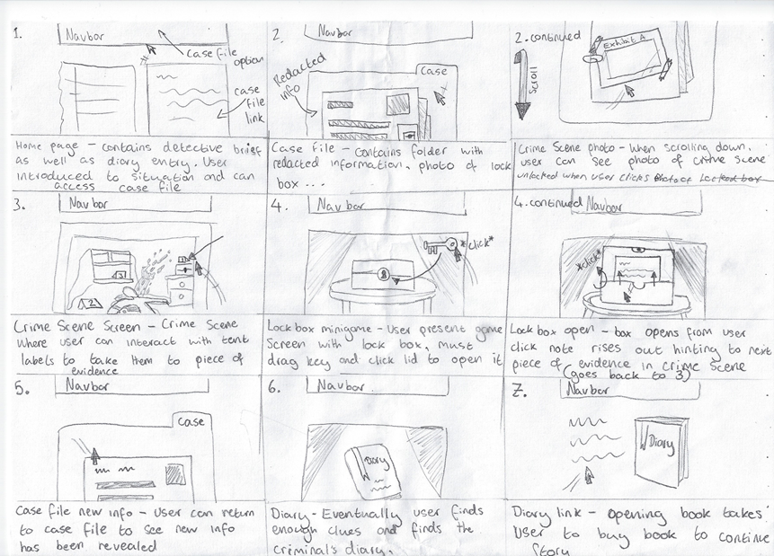
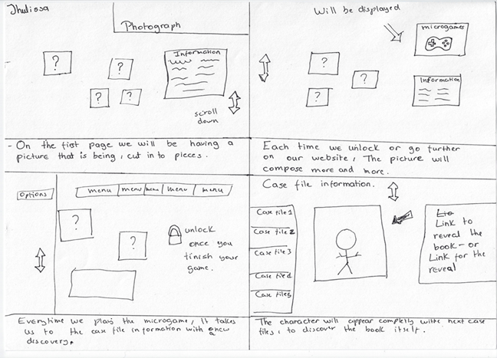
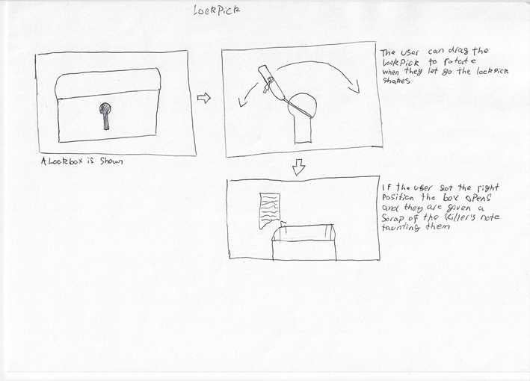
Flow chart
Microgames
User progression though the website
Photograph reconstruction
Lockpick

Slide 5
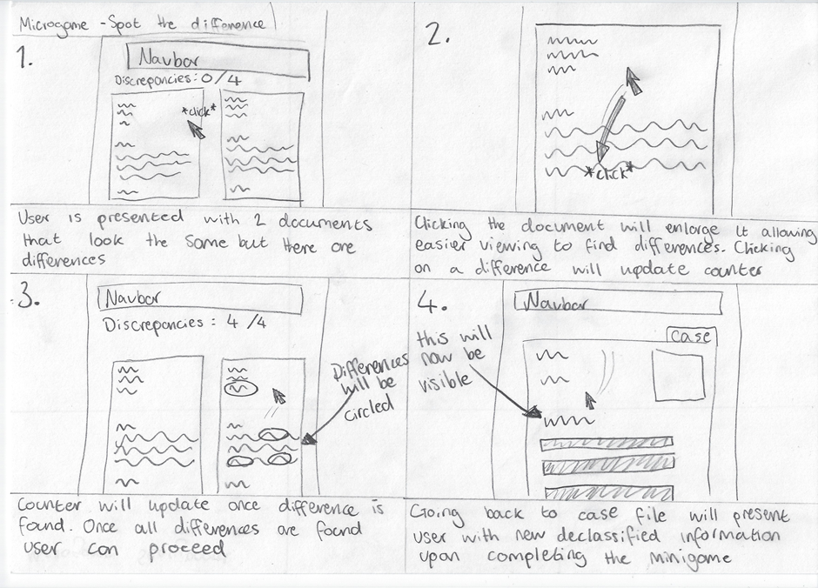
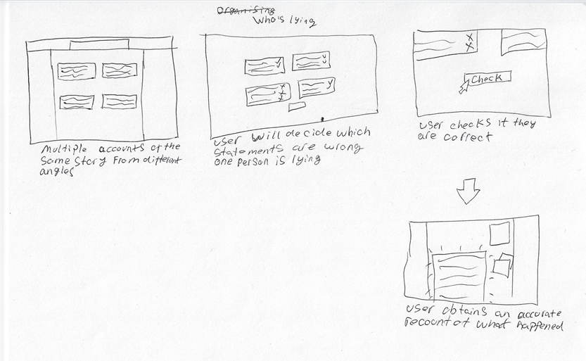
Microgames
Comparing Documents
Spot Statement Discrepancies

Slide 6
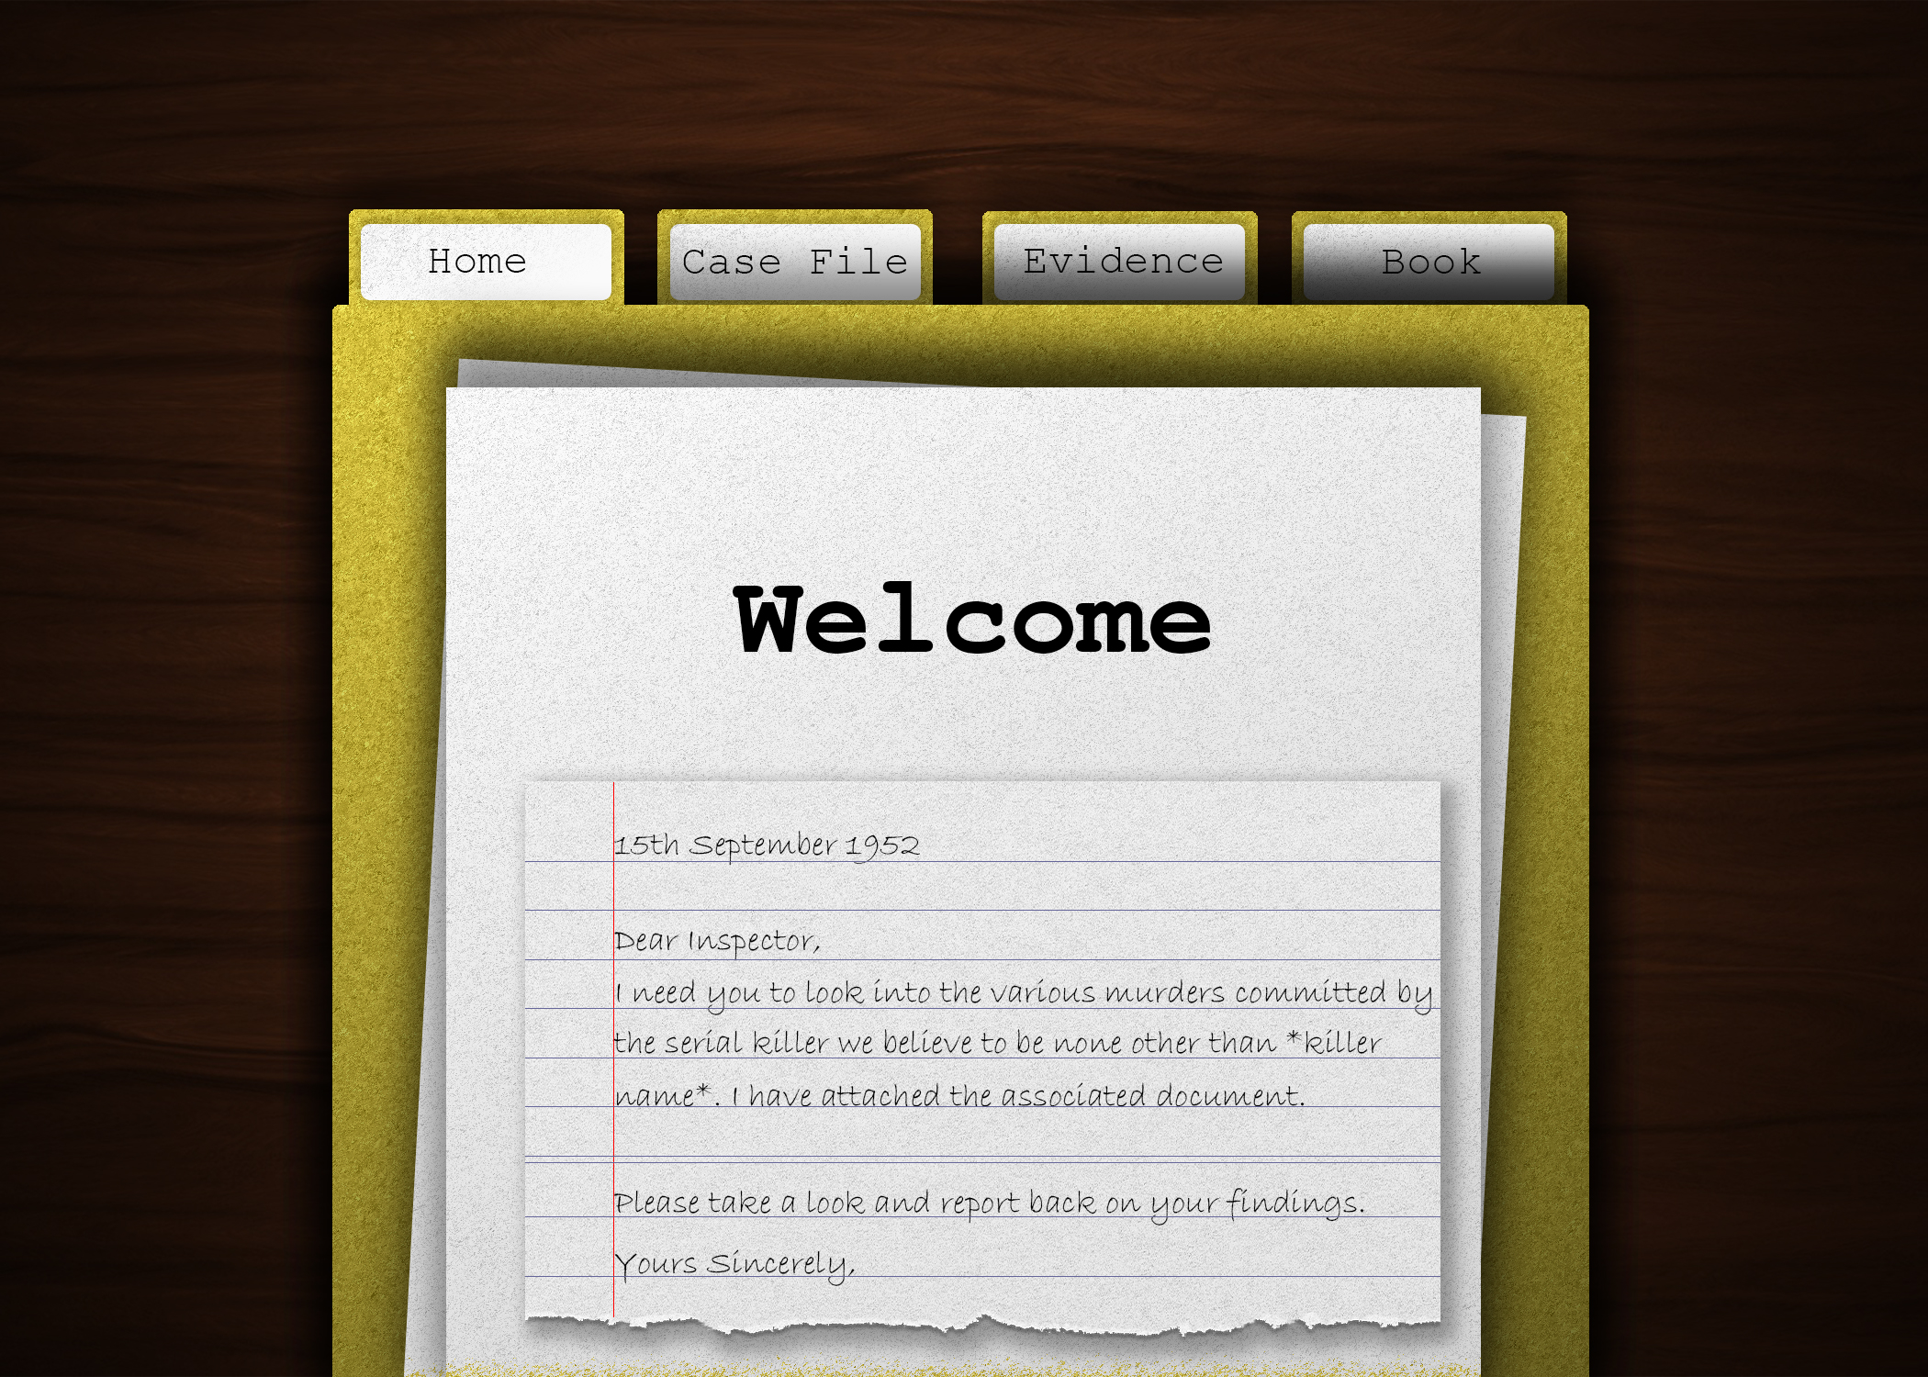
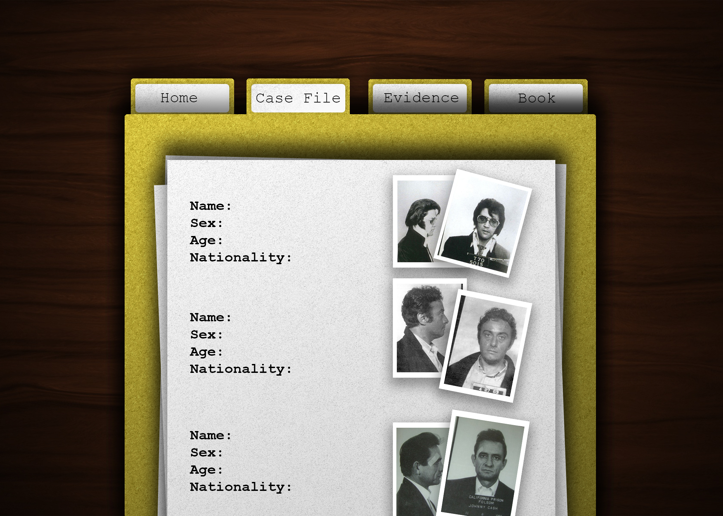
Home page
(High-fidelity Prototype)

Slide 7
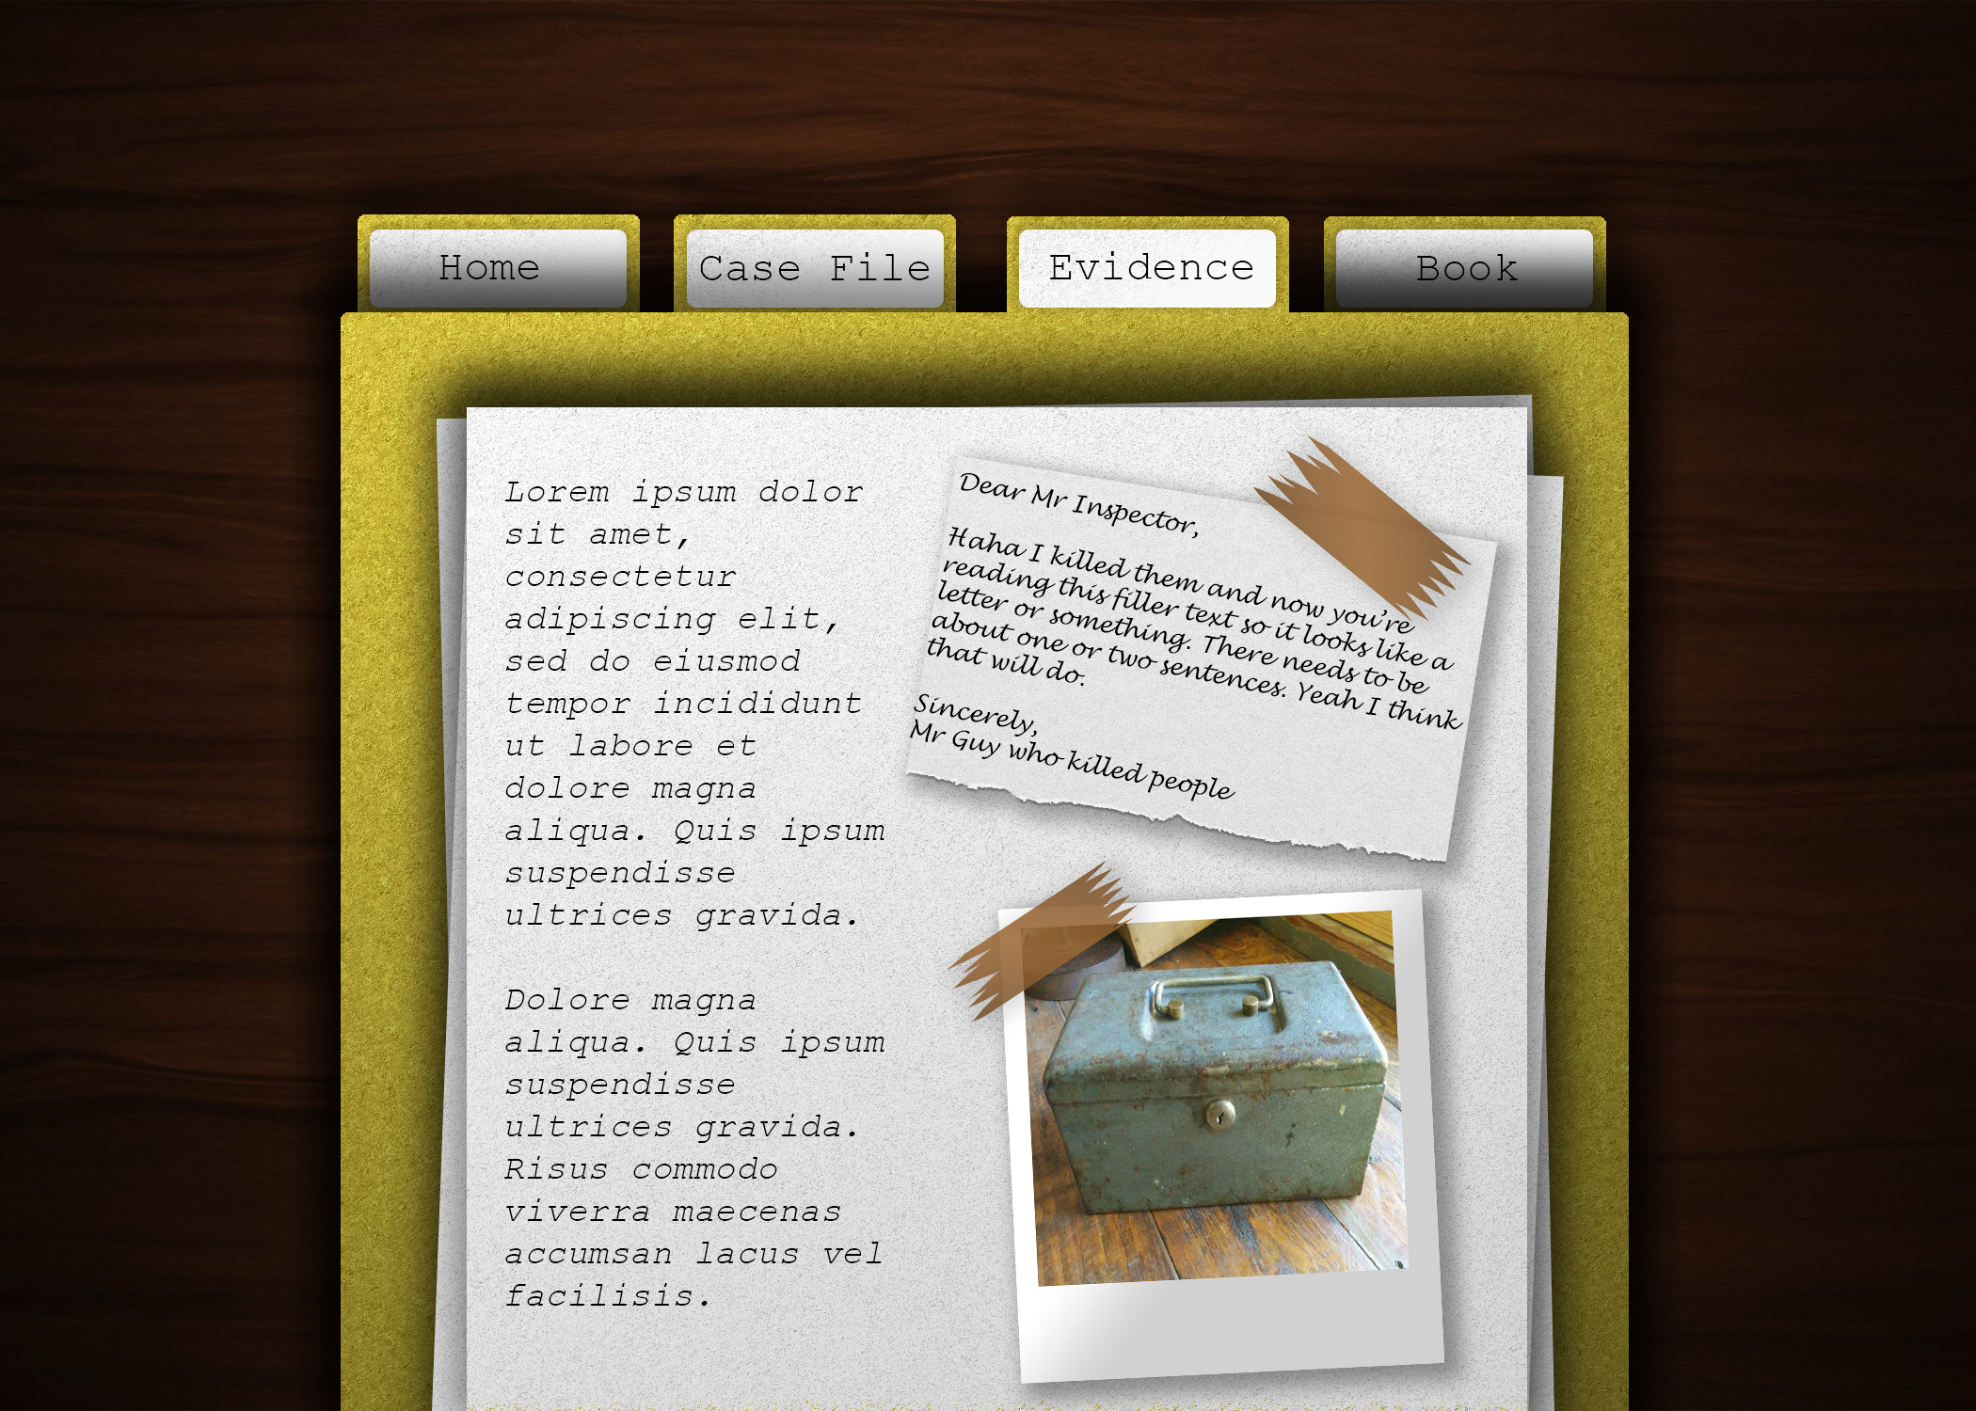
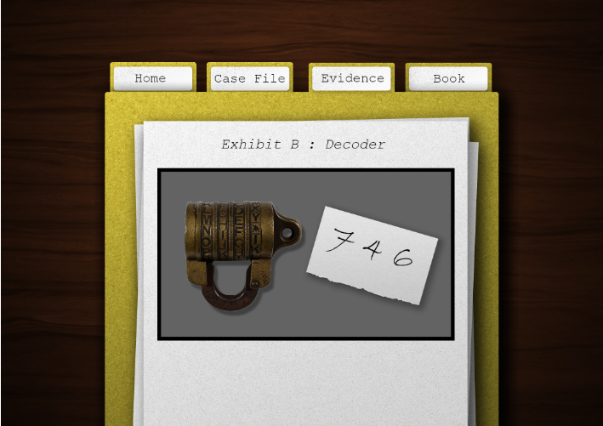
Before: Evidence page
(High fidelity)
Minigame

Slide 8
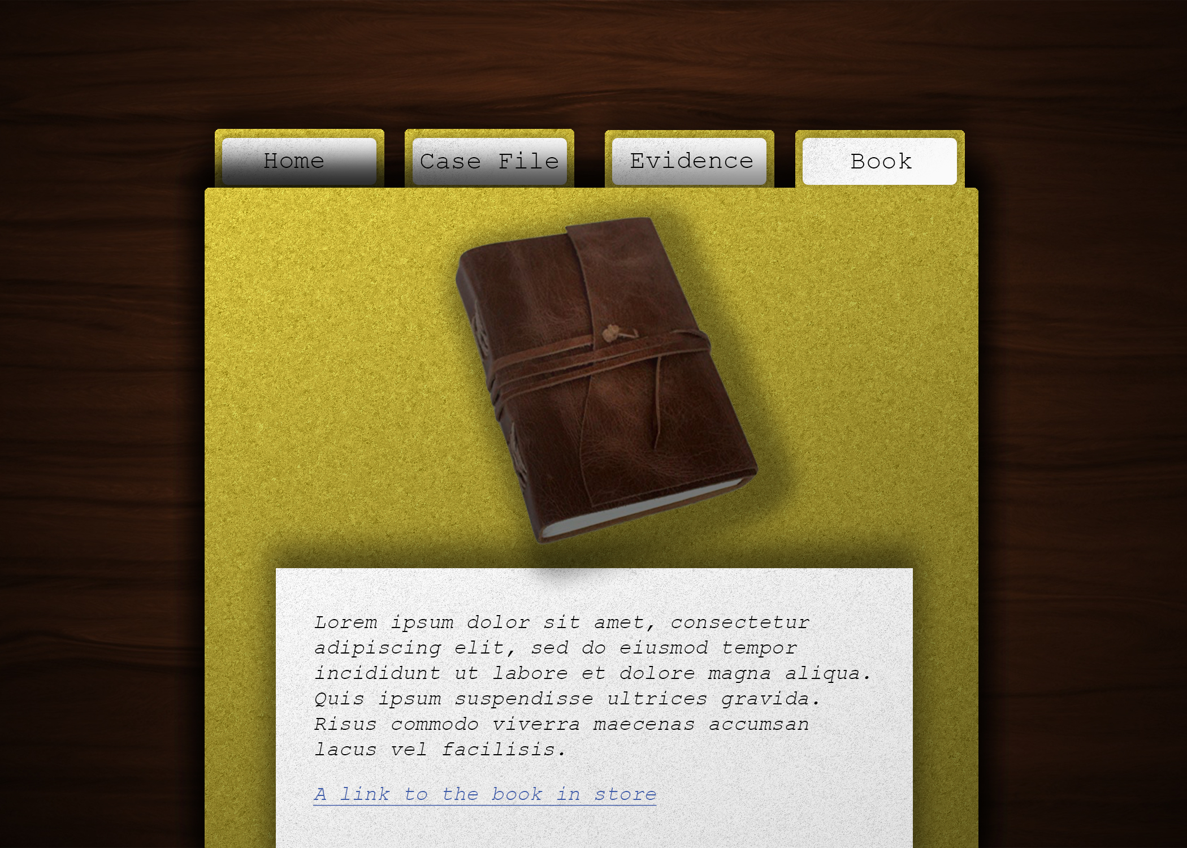
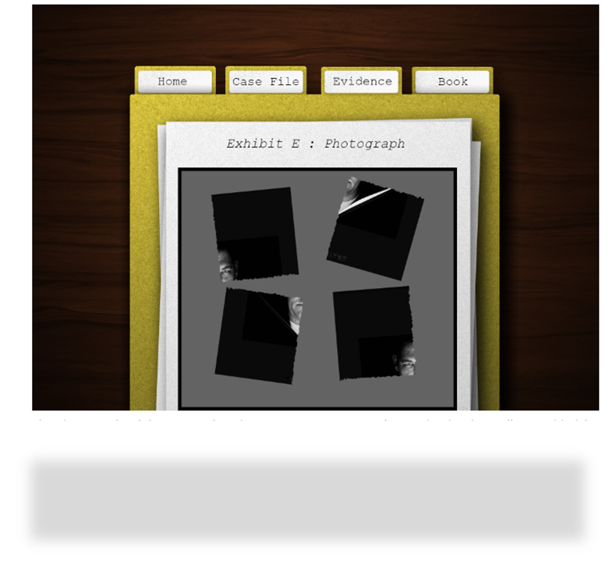
(High fidelity)
Book front cover
Photograph reconstruction

Slide 9

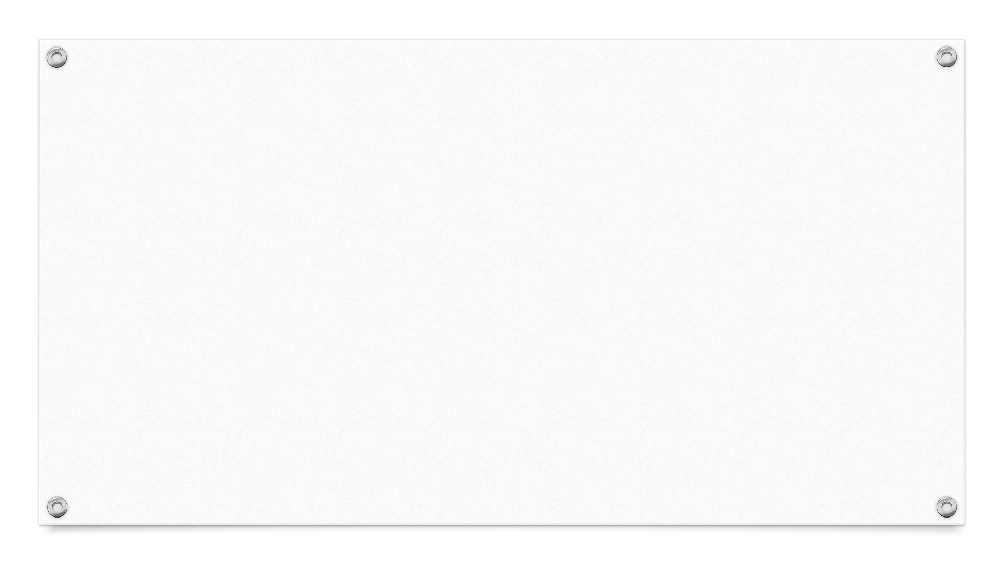
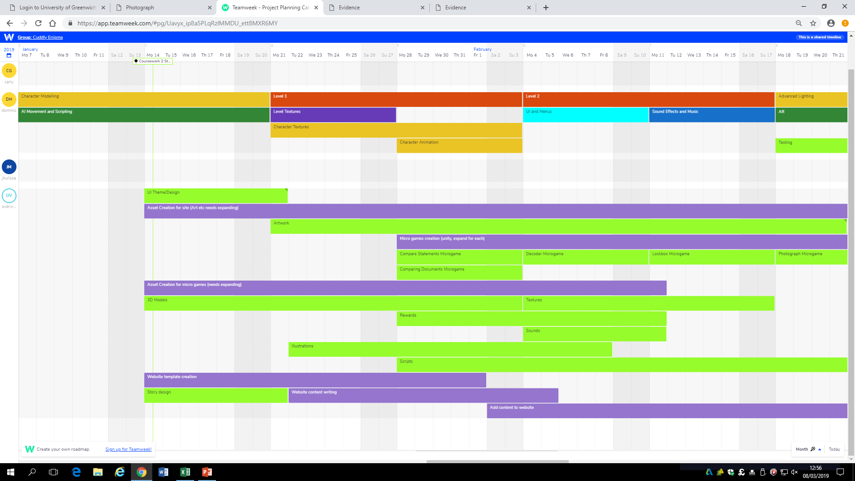
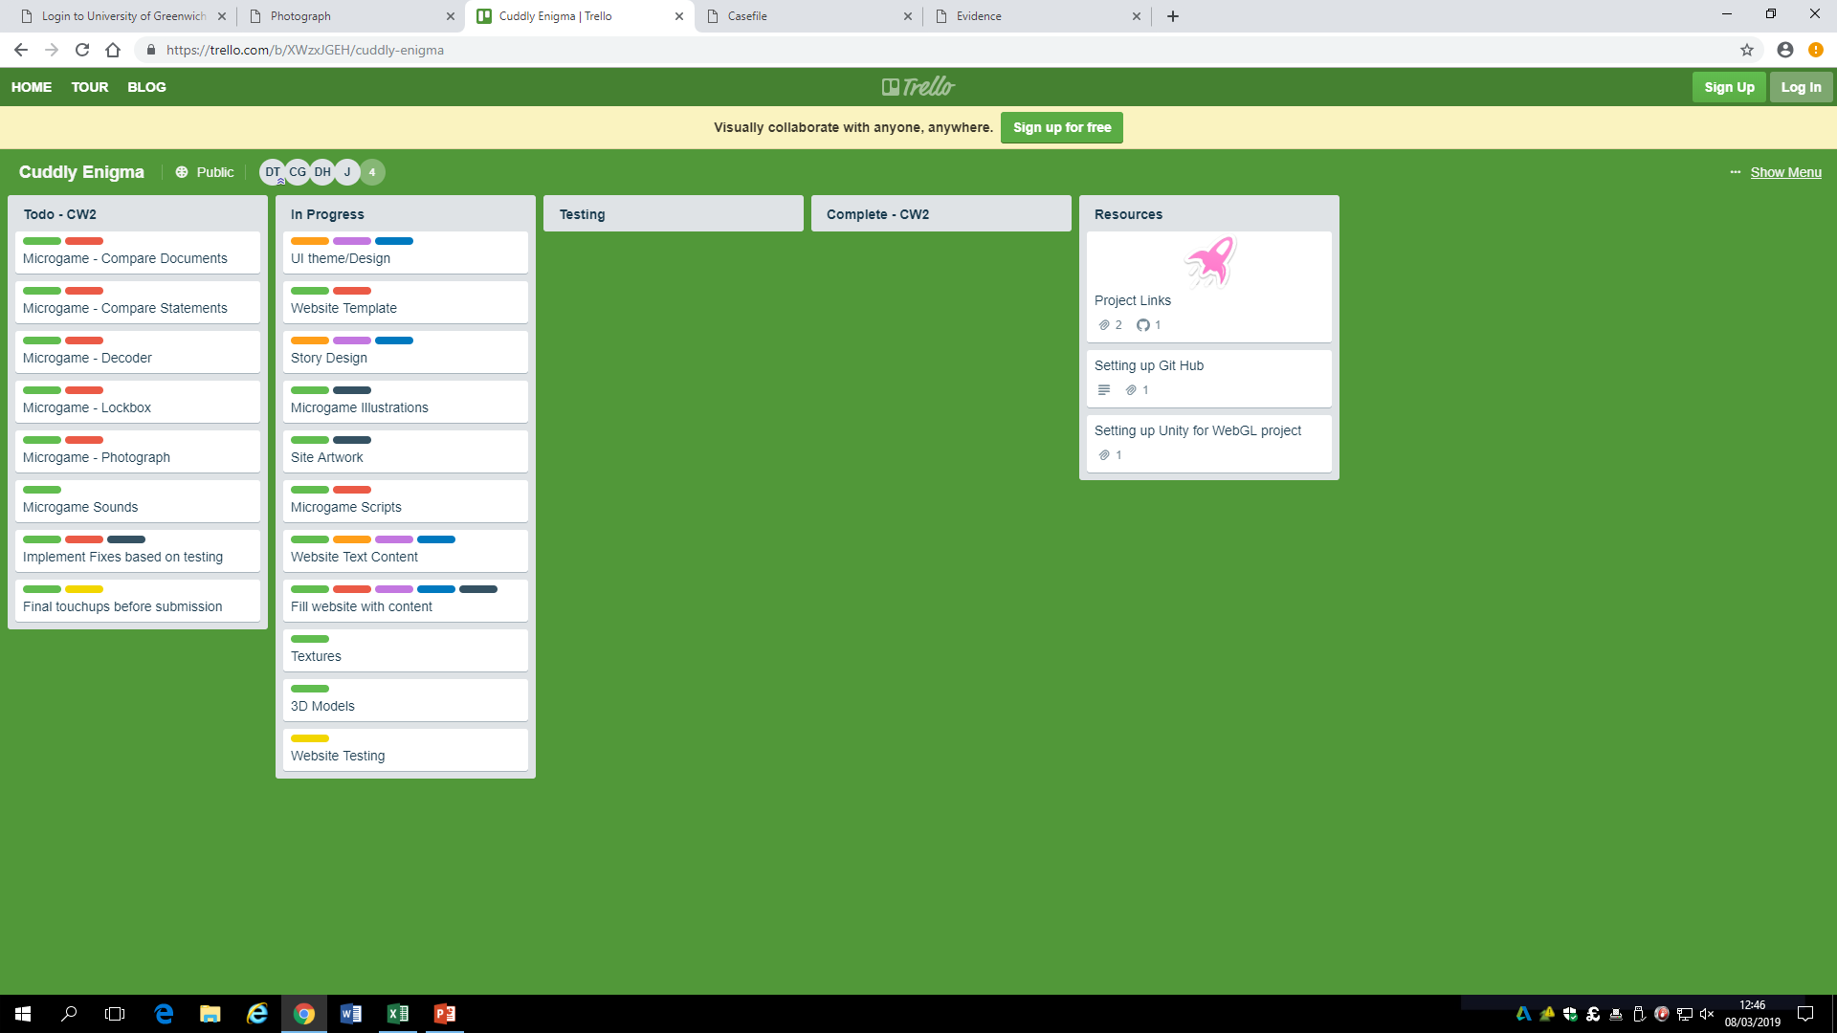
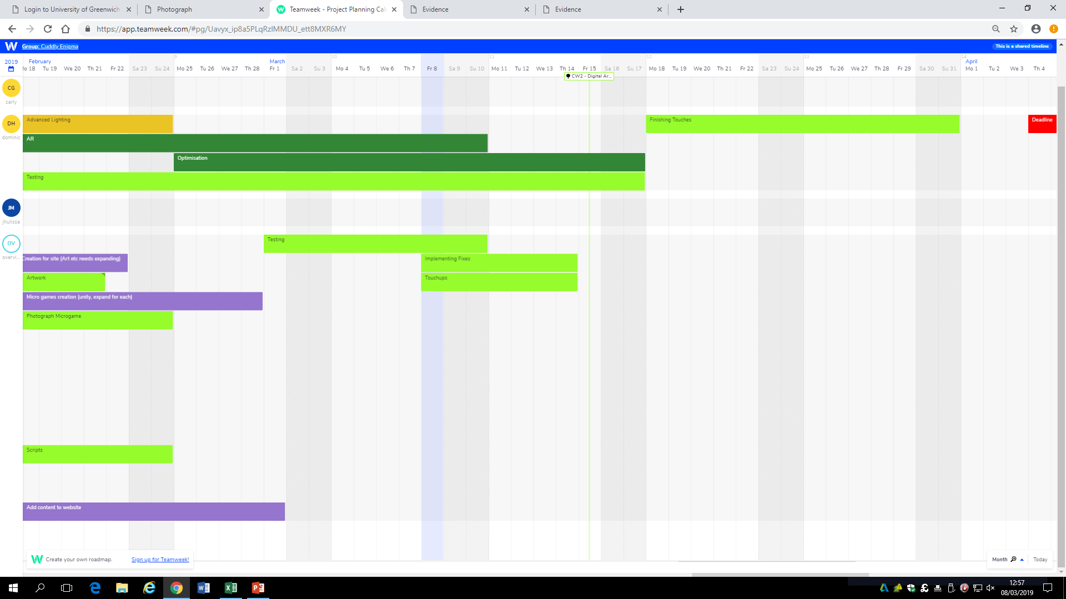
How we kept the process of our project?
Trello
GitHub
Teamweek

Slide 10

DEMO

Slide 11
Feedback:
- Keep book tab open from start, but offer discount for people who finish the book .
-Potential notes page or writing area for people who cannot remember codes, or visual prompts with regards to the code for the lockbox
-Change font size of comparing statements and comparing documents minigame
-Fix notepad issues .
-Integrate start of microgames better into the website.

Slide 12
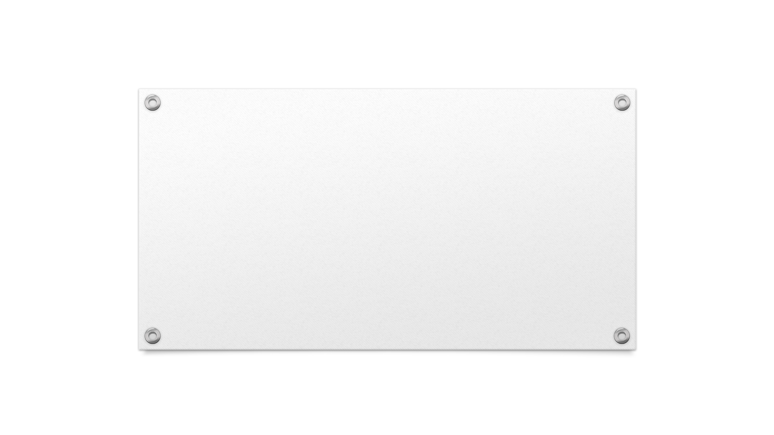

How our future work could be improved ? Any Questions?

Slide 13
Thank you!

